Slide 1




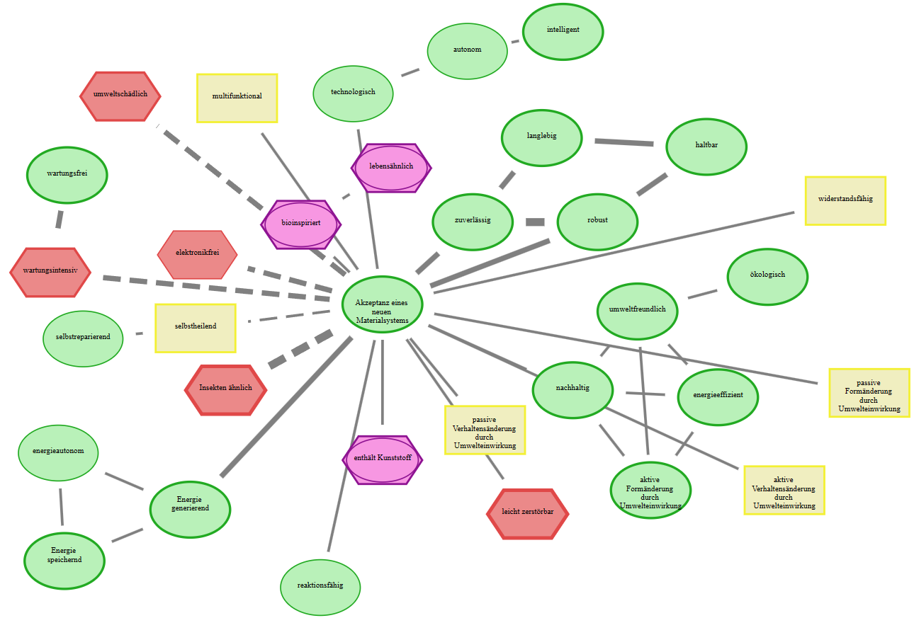
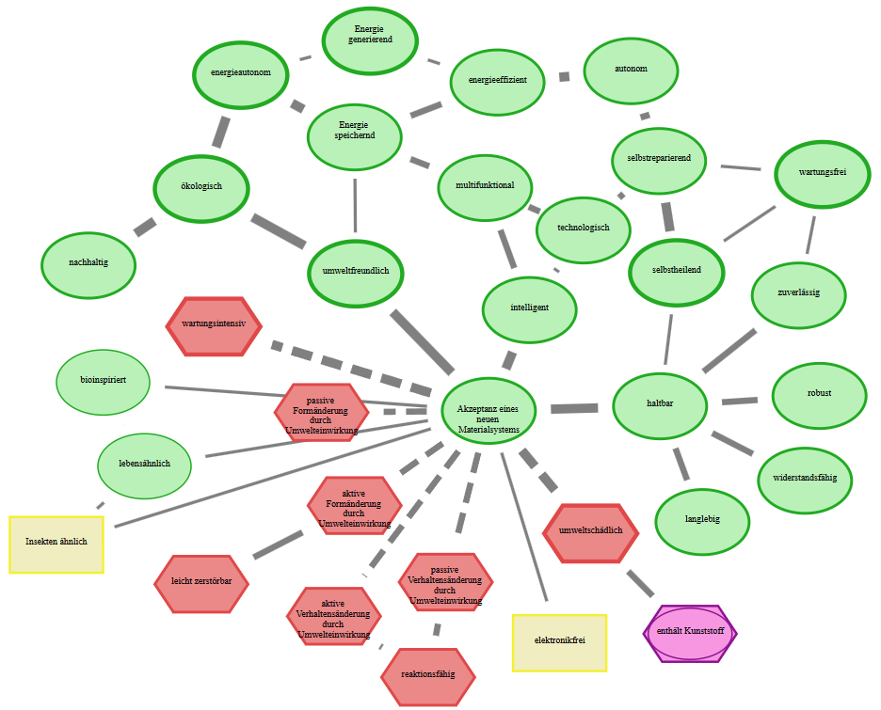
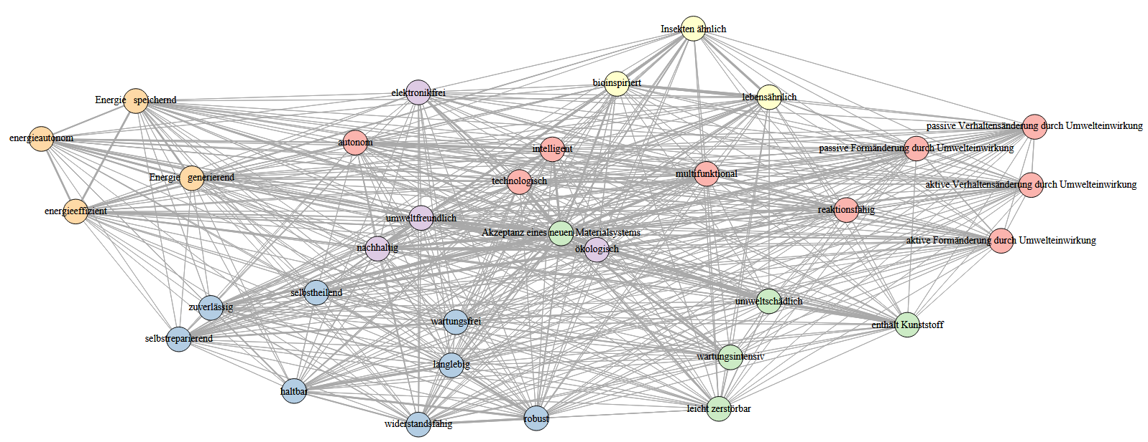
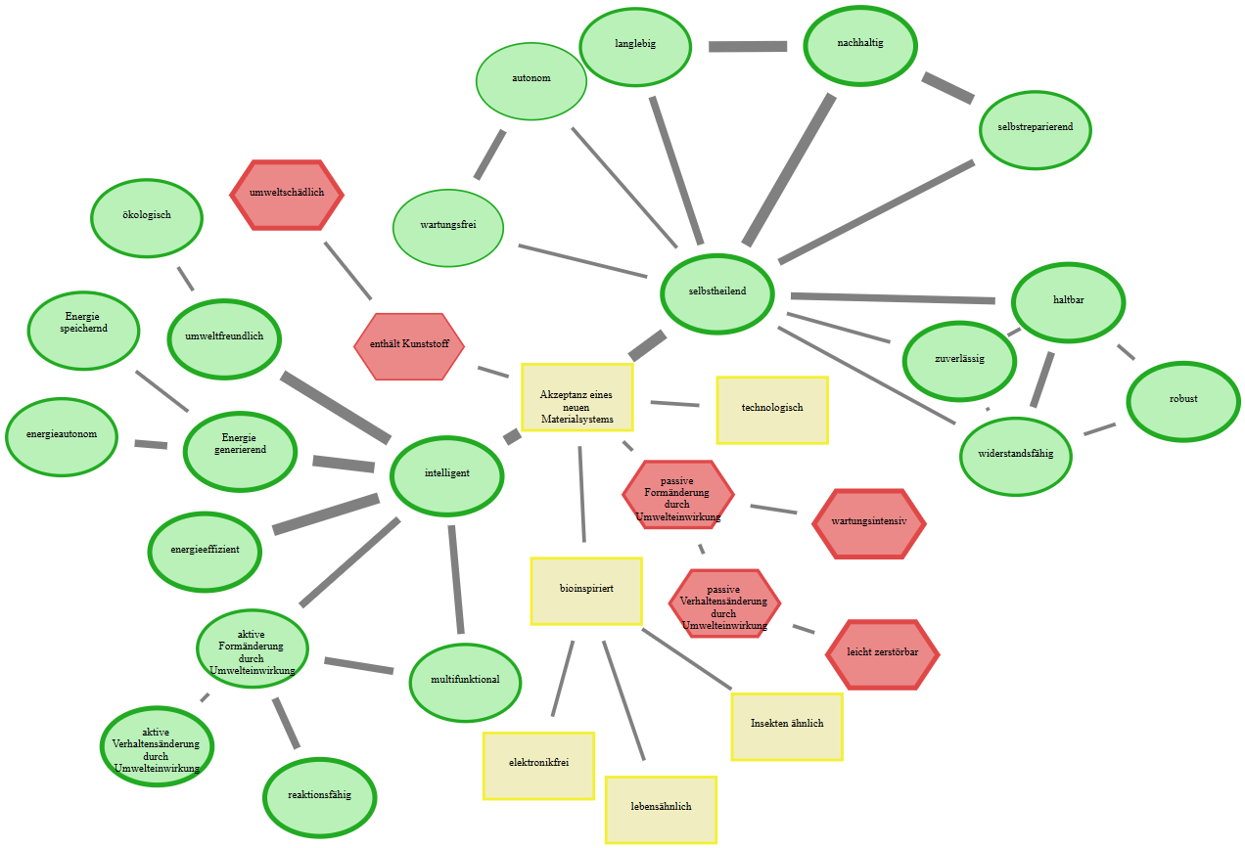
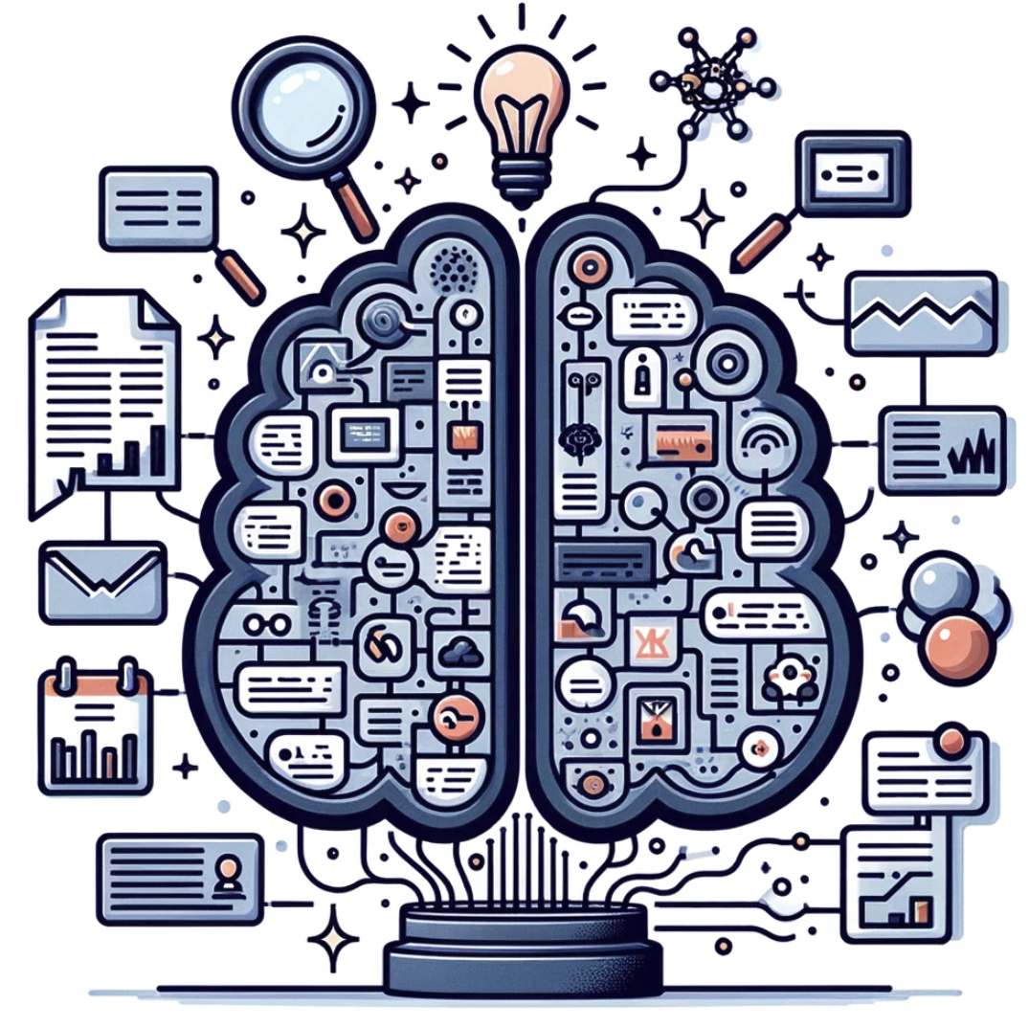
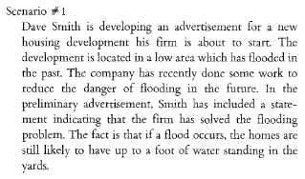
Part I: create a list of basal attributes
(a) Conducted 14 guided expert interviews to create an initial list of basal attributes
(c) Got ratings of 21 experts for (a) the relevance of remaining basal attributes and (b) possible missing's
(b) Reduced initial lists by three raters
(d) Automatically scanned all livMatS for possible relevant adjectives using part-of-speech tagging
Part II: Cognitive-Affective Maps study
Applied analyses on different levels of the CAMs, using especially community detection algorithms
Identified clusters of basal attributes surrounding the central concept
Conducted large-scale CAM study with N=192 laypersons
Part III: use LLMs to create textual descriptions
Used ratings of X experts to check the plausibility of textual descriptions
Positive description
Applied LLMs to create textual descriptions of future material systems using identified clusters
Conducted large-scale study with N=X laypersons to get the acceptance of differently described material systems
Negative description

